Slide 1
Hexadecimal Numbers

Slide 2
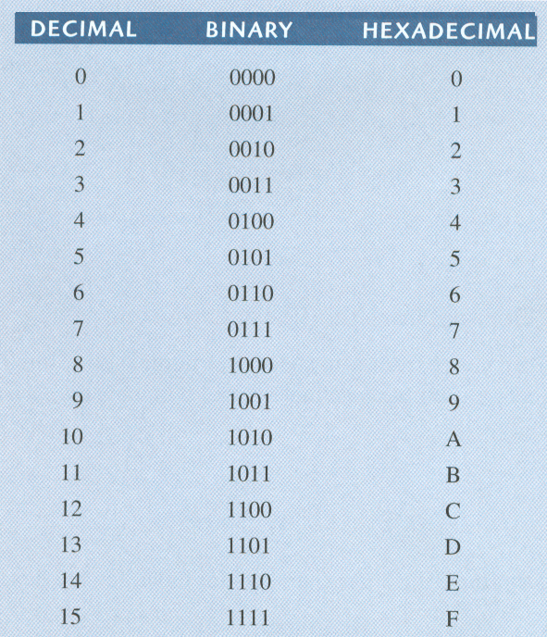
Hexadecimal Numbers
Decimal, binary, and hexadecimal numbers

Slide 3
Hexadecimal Numbers
Binary-to-hexadecimal conversion
Hexadecimal-to-decimal conversion
Decimal-to-hexadecimal conversion

Slide 4


Hexadecimal Numbers
Binary-to-hexadecimal conversion
  Break the binary number into 4-bit groups
  Replace each group with the hexadecimal equivalent

Slide 5

Hexadecimal Numbers
Hexadecimal-to-decimal conversion
  Convert the hexadecimal to groups of 4-bit binary
  Convert the binary to decimal

Slide 6
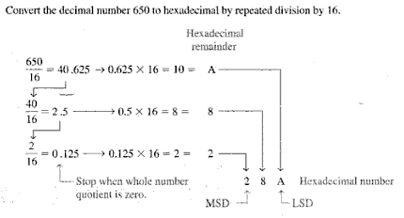
Hexadecimal Numbers
Decimal-to-hexadecimal conversion
  Repeated division by 16

Slide 7
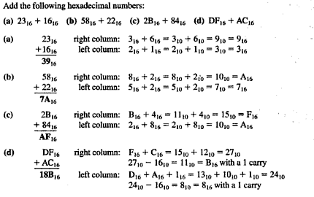

Slide 8
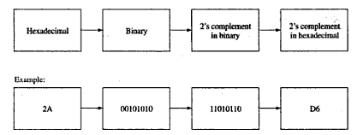

Slide 9
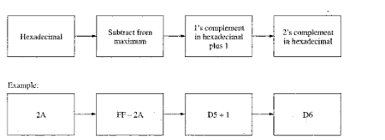
Add with 1

Slide 10

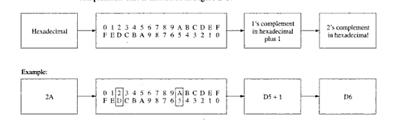

Slide 11


Slide 12

